Slide 1


Research Lab Inventory Tracker Lizzett Tapia Sumedha Bhattacharyaa Jonathan Moore Evan Ross
TA & Sponsor: Shima Hasanpour

Slide 2
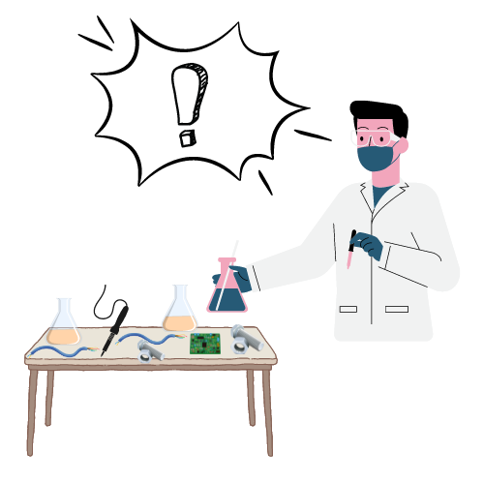
Problem Statement
“The current lab inventory tracking systems at Texas A&M are inefficient, and it is necessary to create new, organized software to increase the overall performance and efficiency of the Lab.”

Slide 3
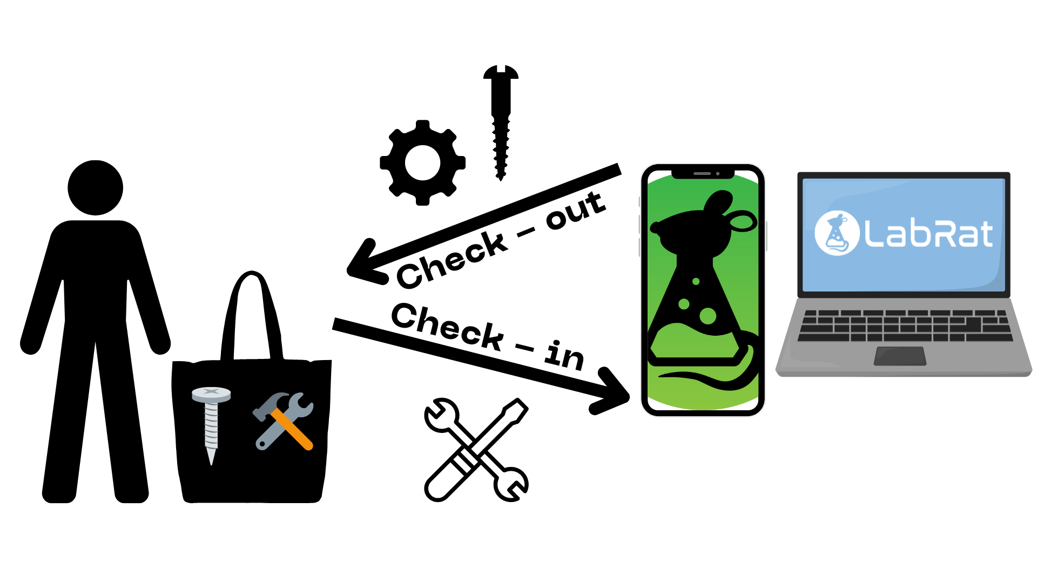
Solution Proposal
“Create a Web app and Mobile counterpart that interact with a database, so that the inventory items of TAMU labs can be intuitively identified, tracked, and altered.”

Slide 4
Interaction of Subsystems
Database
Web-App
Mobile App
Machine Learning Model
Jonathan Lizzett Sumedha Evan

Slide 5
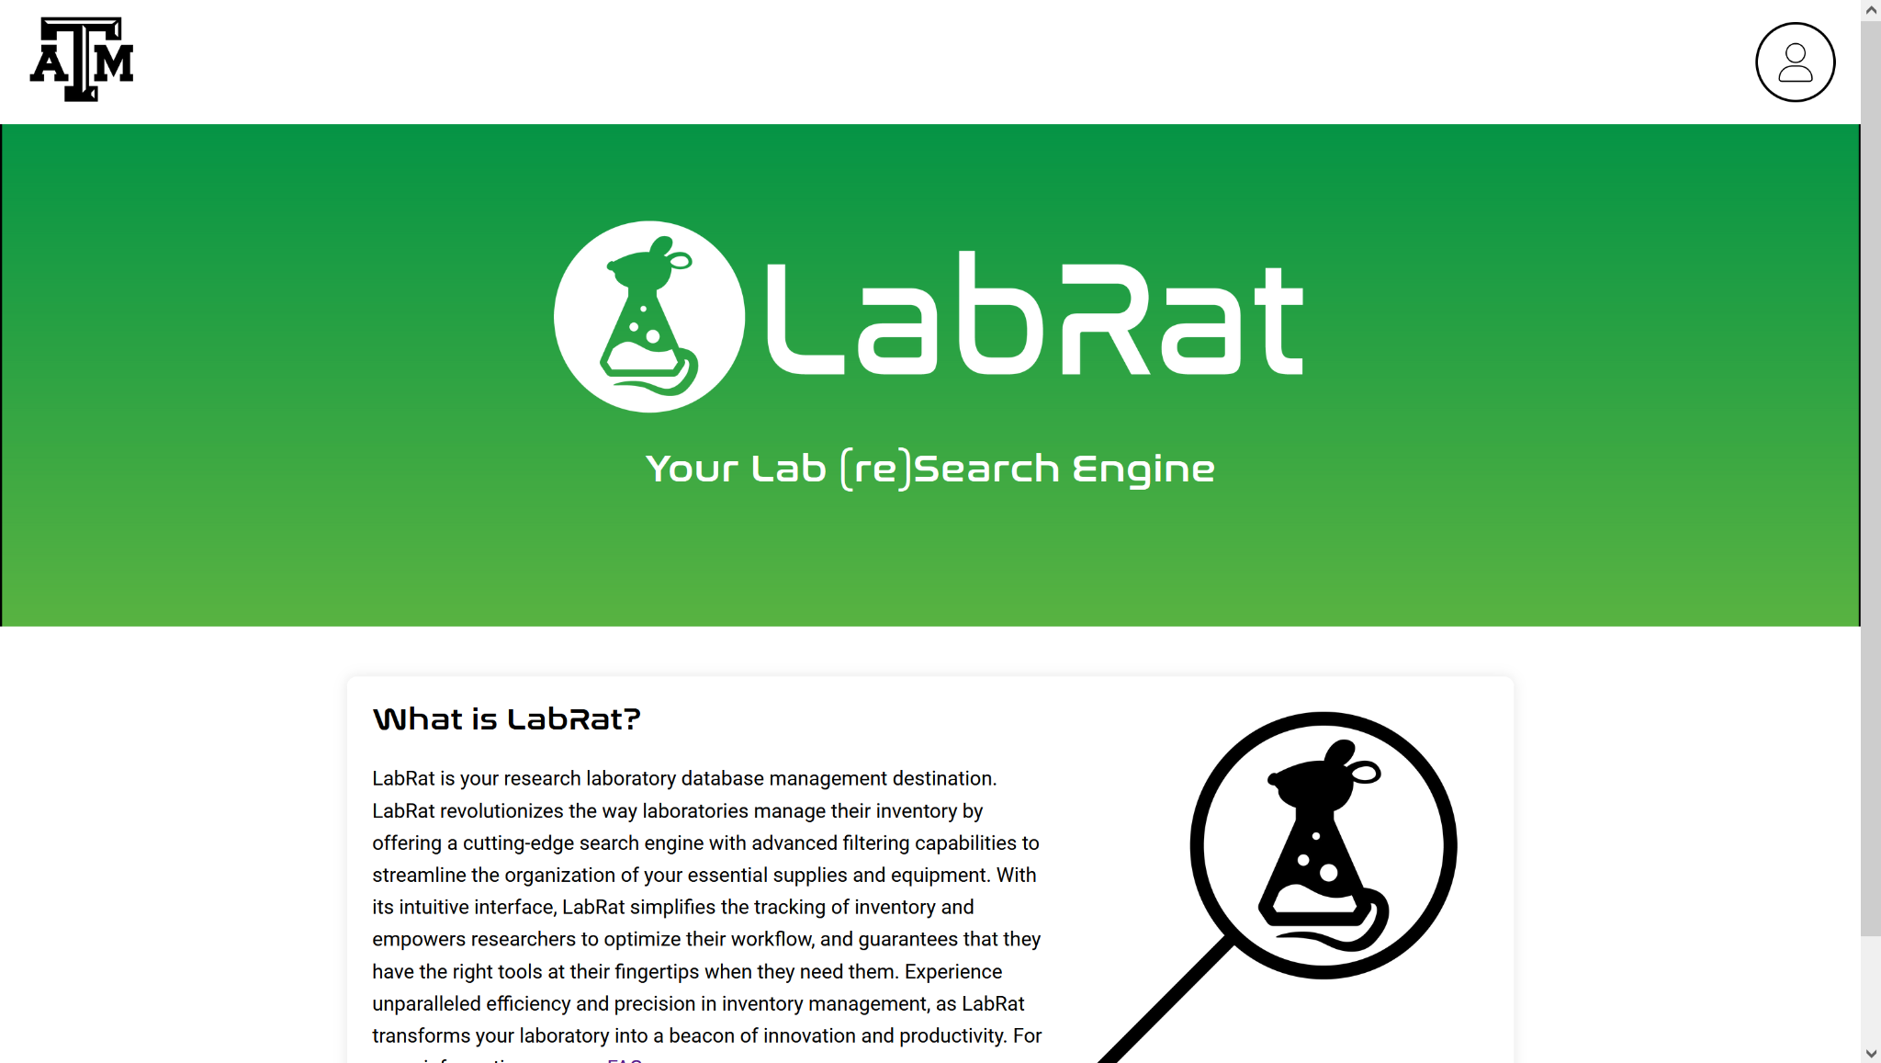
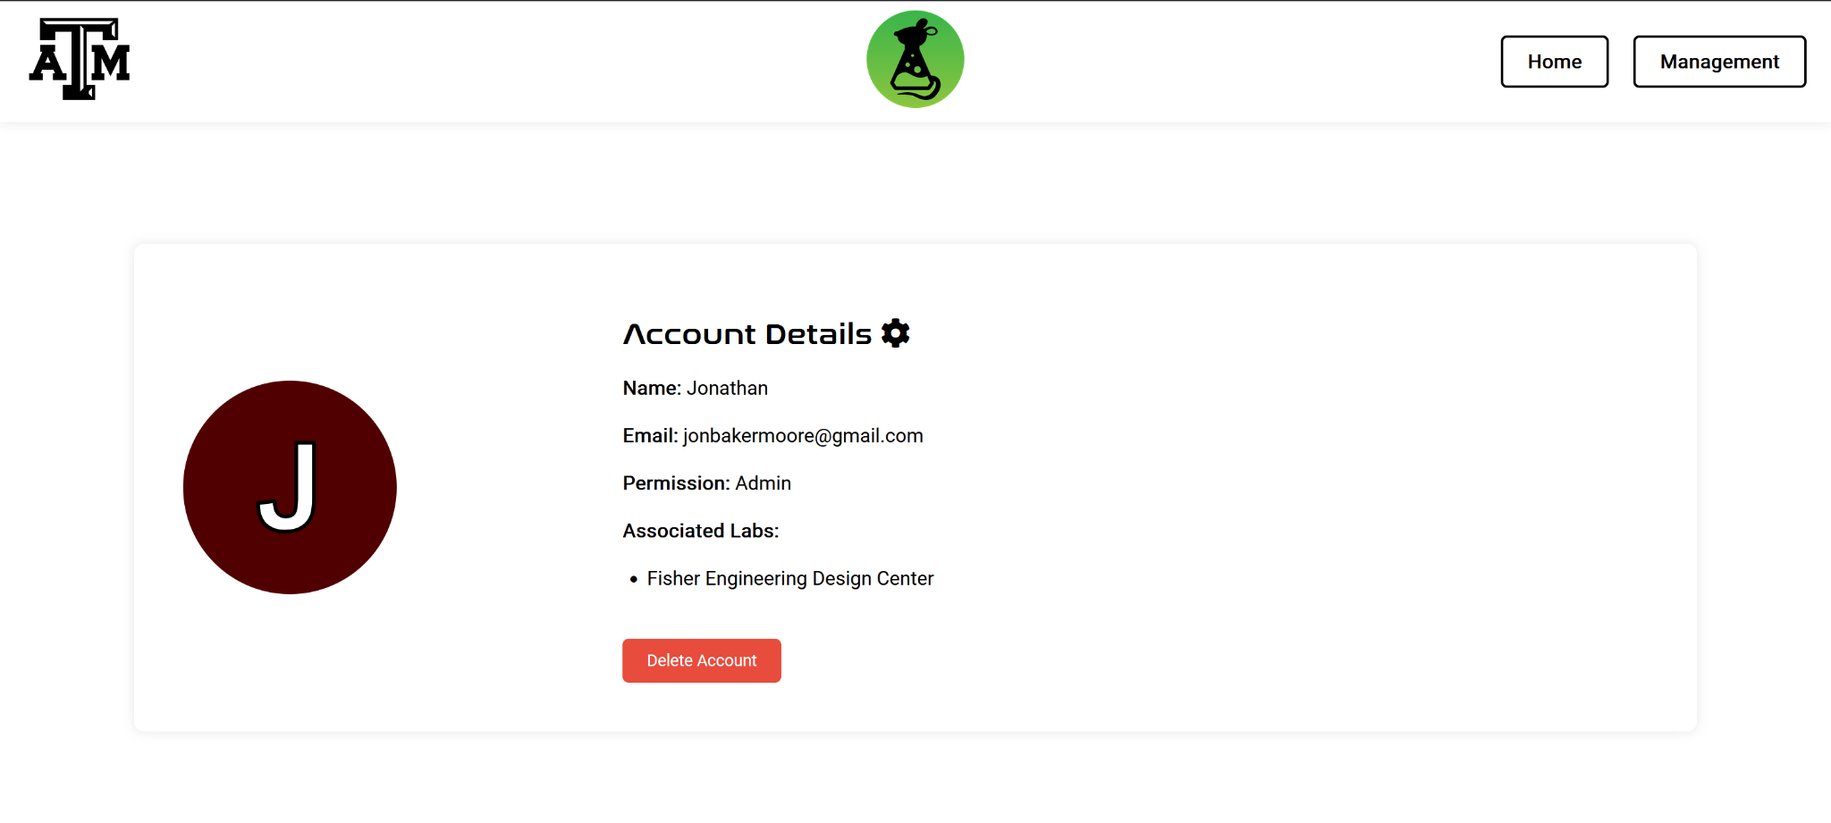
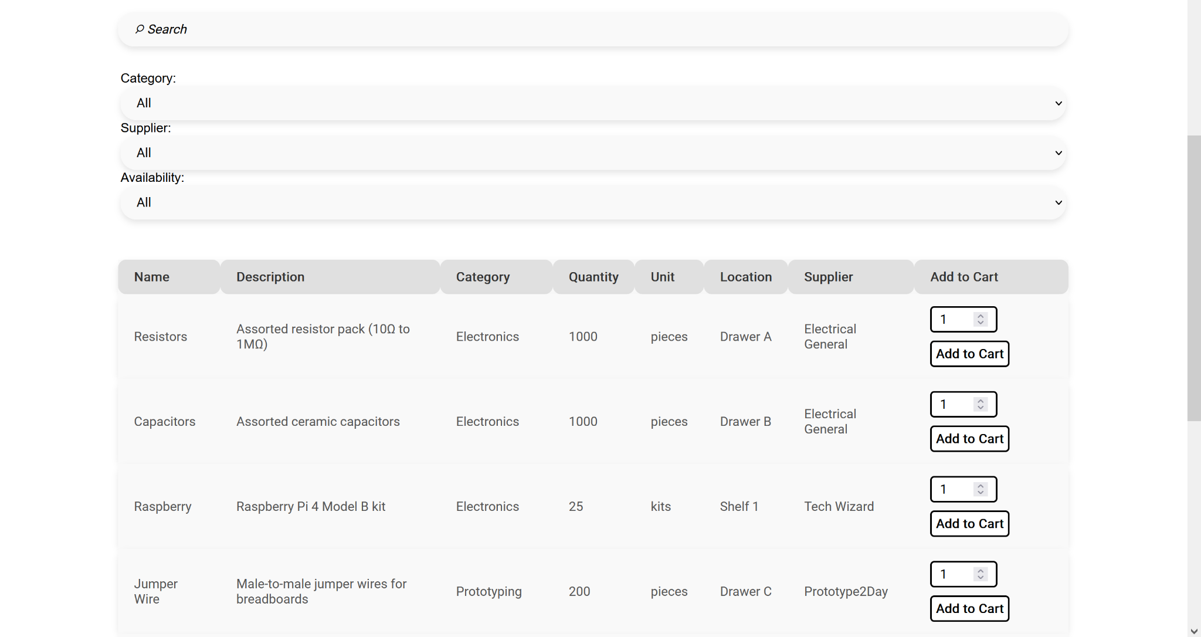
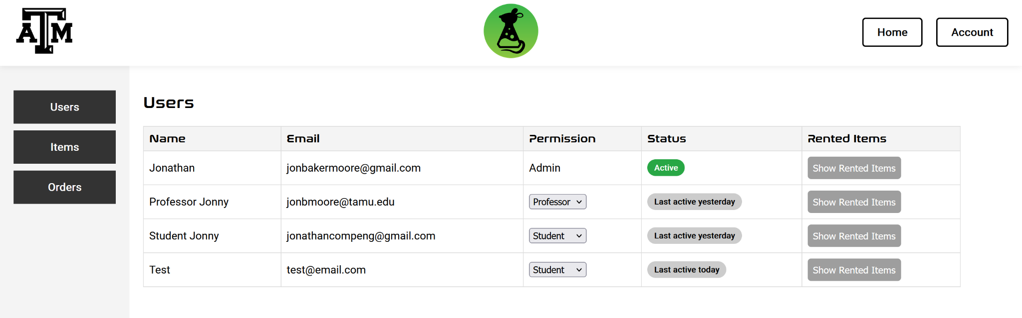
Subsystem Summary: Website
Completed:
Home, Register, Account, Management, FAQ, and Sign-in pages.
Ability to search and check out items
Monitoring all orders placed and the
Server to host the pages locally.
Local database to test functionality.
Input and route validation across many browsers.
More validation needed for Final Demo
404 Plans:
Publish site and connect to project database.
Add email API that uses the DB to send rent reminder emails to users

Slide 6

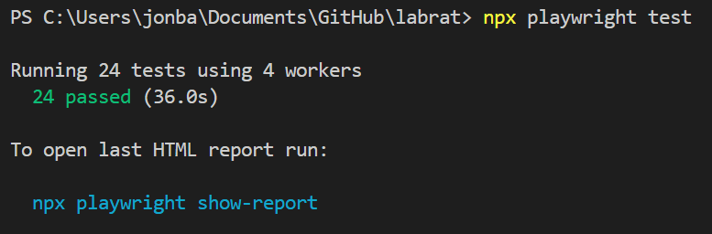
Subsystem Summary Continued: Website
Validated:
Used Playwright to create UI and input tests.
Tests are performed across all browsers (Chromium, Firefox, Edge, Safari, etc.)
Manual testing performed for tests involving permission level changes, as Playwright restricts this for safety reasons.

Slide 7
Subsystem Summary: ML Model
Designed | CNN Model Architecture Data Sets (50/40/10) Data Augmentation (Training) Image Recognition Algorithm Calculating Validation Accuracy
Tested | Training and Validation Phase Used 10 epochs, Adam optimizer (efficiency for multi-class classification) Validation Accuracy Visualized using Tensorboard
Validated (In progress) | Comparing CNN Model against ResNet50 Model Validating with remaining dataset - image path adjustment
ECEN 404 Plans | Understand how to implement the ML Model code into an Android Implement it into the mobile App Test and Train against real snapshots

Slide 8
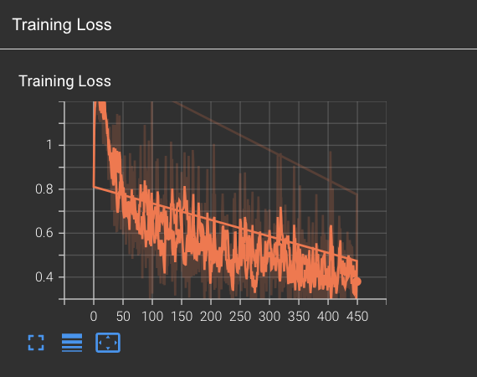
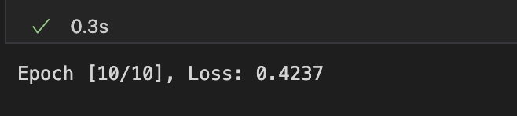
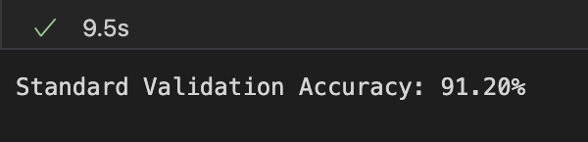
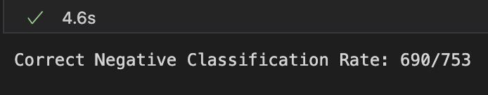
Subsystem Summary Continued: ML Model

Slide 9
Subsystem Summary: Database
Accomplishments:
Defined and created essential tables in SQLite with appropriate fields to inventory-related data
Utilized Python to generate and insert realistic test data
Transitioned to a cloud-based database server: Amazon Web Services
Implemented SQLAlchemy Object Relational Mapper for data migration and testing
Validated database structure in MySQL workbench
Remaining Tasks:
Establish secure access protocols for AWS-hosted MySQL
Limiting access to authorized users
Ensure that sensitive data, remains secure and inaccessible to unauthorized users
404: Connect the database server to website and mobile application

Slide 10
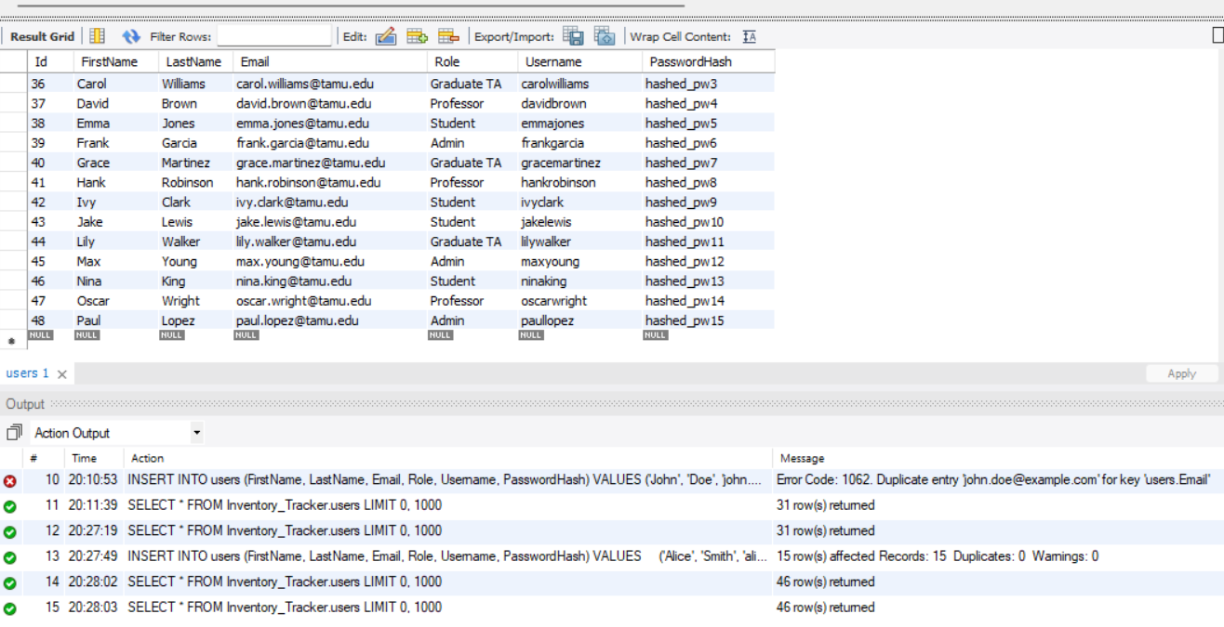
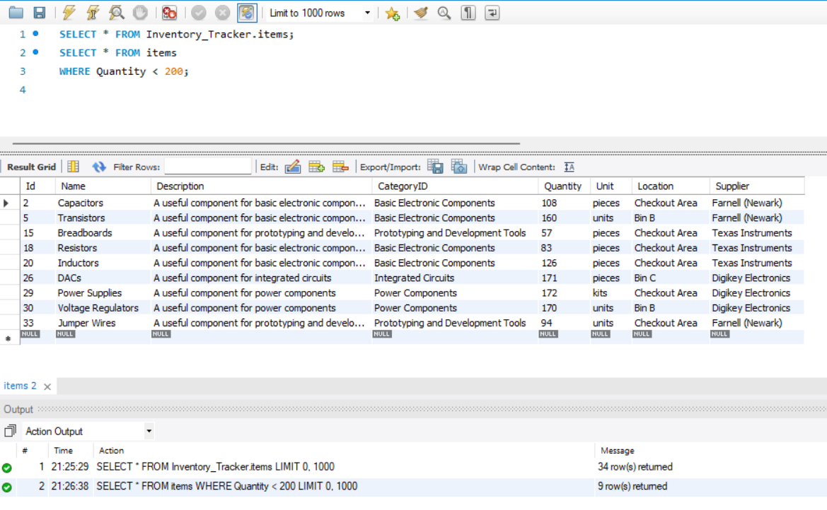
Subsystem Summary Continued: Database
Functional Test Validation & Results:
Insert function was able to insert 15 new users
Extracted specific data
Notes:
database updates correctly

Slide 11

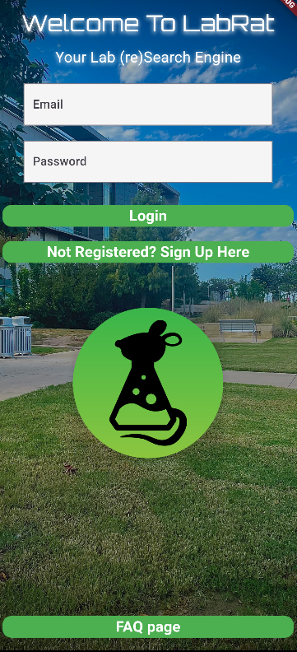

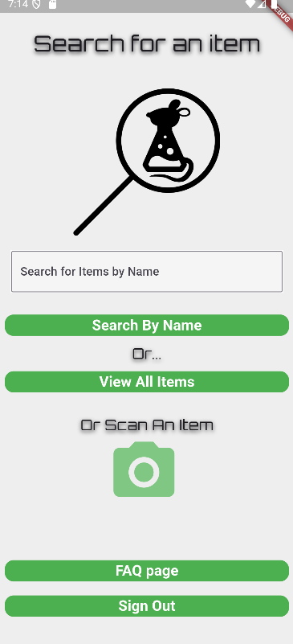
Subsystem Summary: Mobile
Using:
Developing for android phone
Android Studio with Flutter
Samsung Galaxy A30s with android version 12 to test
Completed (part 1):
Created UI for various screens used
Users can register with their email and password and login to access the app.
All information (Users, Items, and Active checkout list) is stored within a local Sqflite database for testing
Camera can be opened and utilized through camera button on home screen
Created an example lab dataset, which can be displayed in the app UI

Slide 12
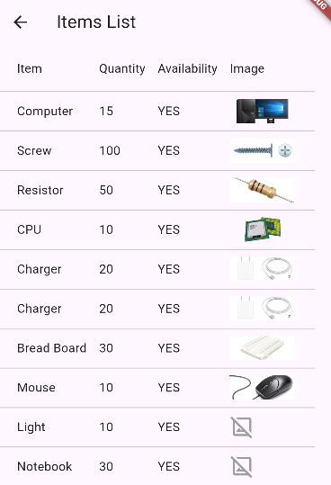
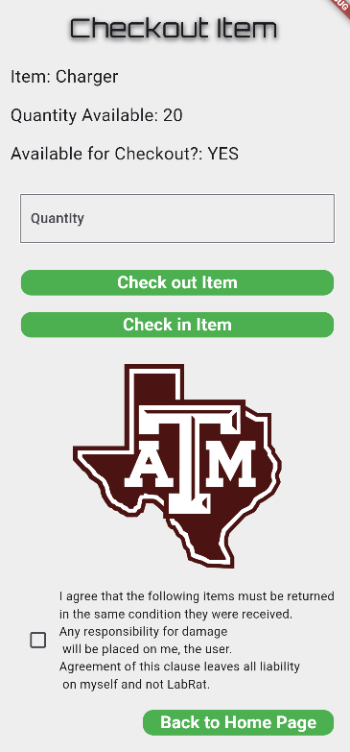
Subsystem Summary Continued: Mobile
Completed (part 2):
Users can search for specific items or they can chose to view all items
Lab Items available for checkout are displayed in a table format with a small picture of the item to the right
Users can check out Items and Check in items that need to be returned
Remaining Tasks for Rest of semester and 404:
Debug Item Images to complete validation
Ensure camera and overall functionality with real smartphone phone
Allow pictures to be taken and passed to machine learning function
link app to database and implement ML model to work within the app

Slide 13
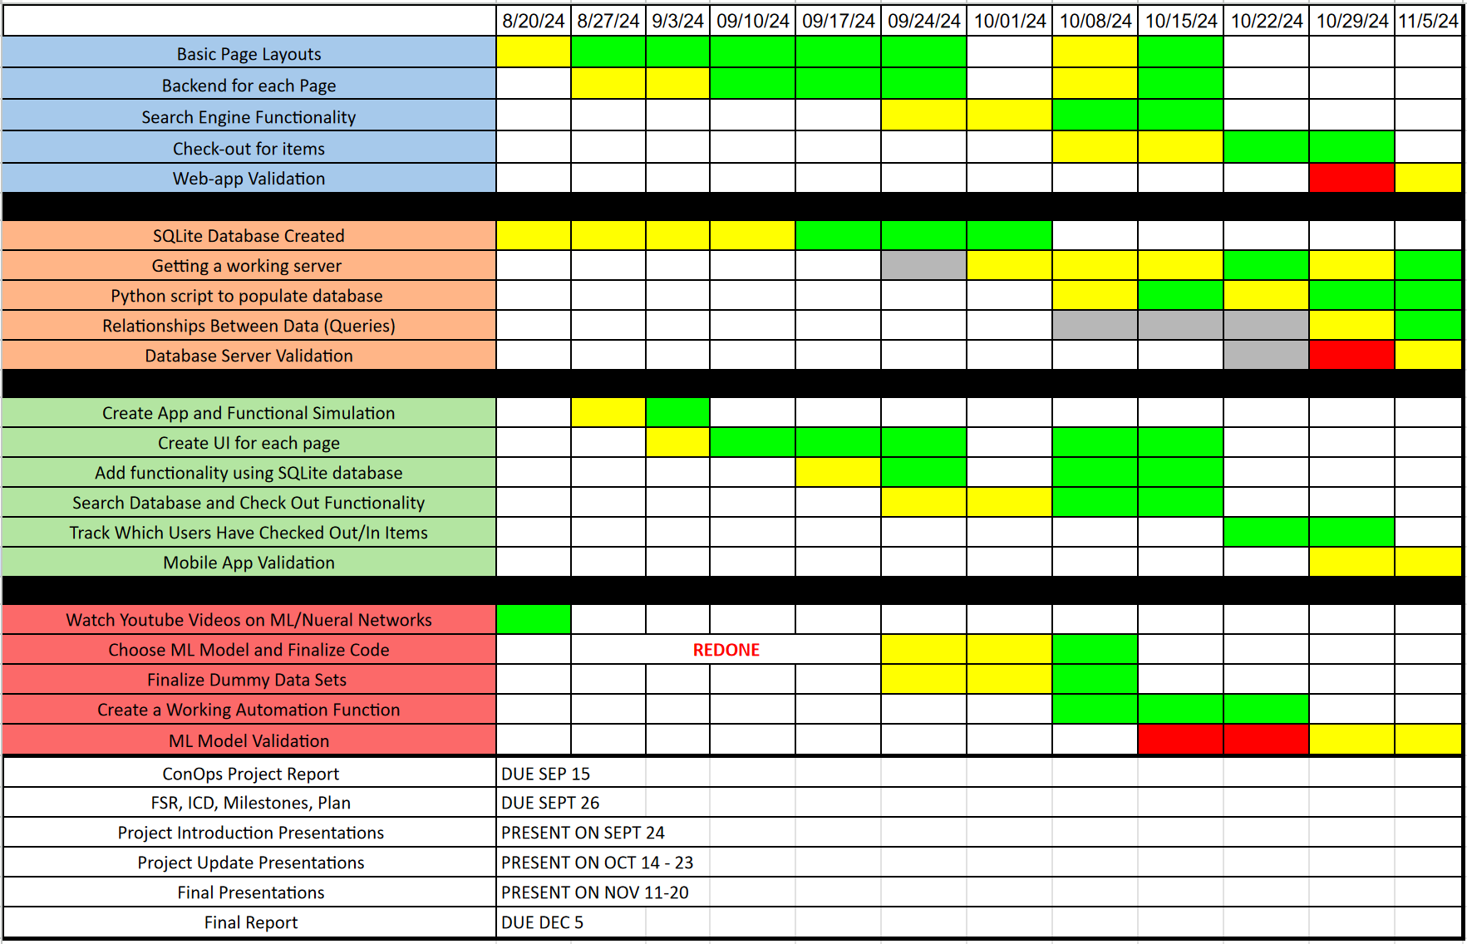
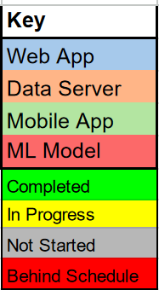
Execution Plan

Slide 14
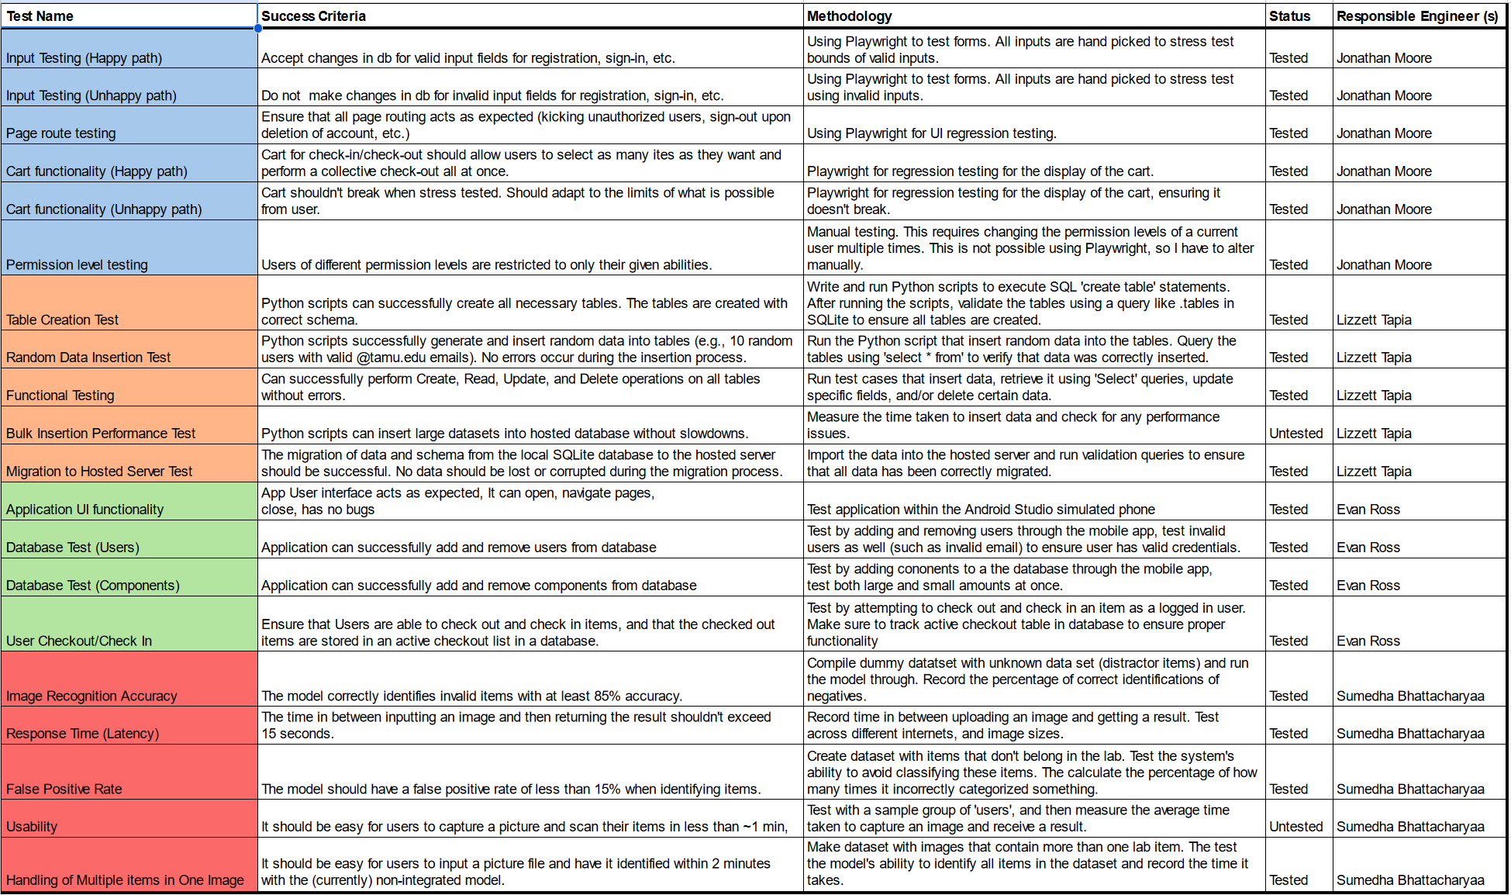
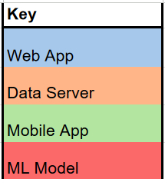
Validation Plan

